Slide 1

Financial Wisdom
For College Success

Slide 2

Notes:
Your investment of time and money in your college education is the first step in building a secure financial future. Yet, too often the financial comfort of new graduates just beginning their careers is burdened by the financial missteps they made during their years in college. This presentation will highlight ways that you can avoid these common missteps and make the most of your investment in college. Knowledge is power.

Slide 3
What is Financial Literacy?
Ability to understand and make informed judgments and to take effective actions regarding the current and future use and management of your money, including:
  Buying choices
  Life issues such as housing, unemployment, medical care, groceries, children, etc.
  Living with a Debt-Free mentality
Notes:
What does financial literacy mean?
The President's Advisory Council on Financial Literacy defines financial literacy as "the ability to use knowledge and skills to manage one's financial resources effectively for a lifetime of financial well-being." Being financially literate allows the student to understand and evaluate their finances and all opportunities available to them to make educated decisions.

Slide 4

What You Need to Know to be Financially Literate

Slide 5
What You Need To Know
Importance of Managing Your Money
Tracking Your Expenses
Creating a Budget
Understanding Financial Aid
Credit Card Basics
Loan Interest & Repayment Calculating
Managing your Credit
Identity Theft
Accessing Resources on and off campus

Slide 6
Statistics Show…
Only 59% of 18-29 year olds pay their bills on time every month.
  National Foundation for Credit Counseling and MSN Money, 2008.
Three our of every four American say they aren’t saving enough.
  Pew Research Center, 2008.
85% of college graduates plan to move back home after graduating.
  Twentysomething, Inc, 2010.

Slide 7

College is Expensive!
Notes:
Let's face it: getting an education is expensive! Students today are faced with higher debt levels than ever not to mention confusing repayment options, multiple debt holders and a rough job market. Unequipped with the resources needed, students leave college with tremendous amounts of credit card and/or student loan debt with no idea how they are going to afford to pay them off. Our goal is to address this problem!

Slide 8
How to Begin Building a Solid Financial Foundation
Ask yourself these questions:
    What money issues have you and your family experienced?
    Why do you experience money issues?
    What messages have you received about money and spending?
    Do you have a plan for how you are going to cover the cost of your education and living expenses?
Notes:
In order to begin building a solid financial foundation it is important to start asking yourself some questions: (read all questions on slide)
What money issues have you and your family experienced?
Why do you experience money issues?
What messages have you received about money and spending?
Do you have a plan for how you are going to cover the cost of your education and living expenses?
The answers may surprise you. You may not even know the answers to some – but we are here to help!

Slide 9
Do you have…
Poor Financial Literacy?
Spends money carelessly
Borrows excessively
Does not save money
Has bad credit and high interest payments
Smart Financial Literacy?
Follows a budget
Limits debt (has a zero debt goal)
Pays bills on time
Effectively manages credit
Notes:
Students with poor financial literacy tend to spend money carelessly and borrow it excessively. They do not save money and tend to have bad credit and high interest payments. On the opposite hand, students with smart financial literacy are able to follow a budget, limit their debt, pay their bills on time and also manage with credit effectively. So which do you have?

Slide 10
Budgeting 101
Track your spending habits
Calculate your income
Identify your expenses
Set goals
Make a budget and stick to it
You can find resources for all of these steps at the TSCPA website.
Notes:
Budgeting lays the foundation for overall financial planning. For healthy financial literacy you should learn how to track your current spending habits, calculate your income, identify your expenses, set goals and create a final budget

Slide 11

Where is Your Income Coming From?
In order to spend money, you need to have it.
Notes:
The first step to creating a successful budget is to know how much money you have coming in. It is important to not only calculate the regular income that you have coming in as take home pay from work but also any other sources on income such as financial aid, work study, money received from friends or family, interest earned on checking/savings accounts, etc. This list is open-ended and varies for each student.

Slide 12
Where is All of Your Money Going?
Track all expenses
  Regular monthly expenses
  Novelty items
Consider the unexpected
  Car repairs, fuel price increases, health care costs
Notes:
The next step is to know where your current money is going. It helps you recognize how much money you really are spending and where it is being spent. Carry a small notebook and write everything down from a soda from the vending machine to your rent payment.

Slide 13


Establish Financial Goals
Short Term
  Buy a car
  Buy a new computer
  Buy new furniture
  Be debt free
  Pay monthly bills on time
Long Term
  Buy a home
  Start a business
  Start a family
  College tuition for children
  Pay off student loans
  Retirement
Notes:
Next, you need to determine what financial goals you have for the future.
Determine your short-term goals. These are goals that can be achieved in about 2-3 years such as purchasing a car.
Also Determine your long-term goals. These are goals that can take between 5-7 years to achieve, or even longer if needed! These could include retirement or buying a home.

Slide 14
Define Needs vs. Wants
Needs are fixed expenses
necessities for everyday living & goal attainment.
Rent/Mortgage
Utilities
Food
Clothing
Transportation
  Taxes
  Health Care
  Child Care, etc.
Wants are variable expenses
things that are nice to have & gratify some desire or urge.
Entertainment
Cable/Satellite
Internet Service
Magazines
Eating Out
Cell Phone
Hobbies/Sports
Notes:
The last and most important step is to create a final budget. You will need to compare the money that you have coming in with the money that you have going out. If your expenses are greater than your income, you have two options: identify ways to cut your spending (needs vs.) wants and/or look for additional ways to increase your income.

Slide 15

Financial Aid 101

Slide 16
Ways to Pay for College
Most students cover the cost of college through a combination of the following resources:
Personal Savings
Employment
Parent/Family Financial Support
Gifted Financial Support
Federal Student Aid Student Loans
Grants
Work Study
Scholarships
Visit CollegeBoard.com for help understanding your options.
Notes:
Most students use a variety of ways to assist them in paying for their education. These range from self-funding your education to support from outside sources such as friends or family, financial aid and/or scholarships. It is important for you to become familiar with all of these options and determine which you are able to utilize.

Slide 17

$185 BILLION in aid is available
There are four main sources:
Federal government
State governments
Colleges and universities
Private organizations

Slide 18

Start With The FAFSA
The FAFSA application gives you access to these types of aid:
Grants and scholarships: money you don’t have to pay back
Work-study jobs: paid, part-time work that’s generally on campus
Loans: money you need to pay back, usually after you graduate
www.fafsa.gov
Notes:
To qualify for many types of aid, you’ll need to complete the Free Application for Federal Student Aid (FAFSA).
The FAFSA isn’t only for federal aid
The FAFSA qualifies you for federal aid, but many state governments and colleges also use this application to award their own aid.
Complete the form online at www.fafsa.gov or download paper forms there. You can even import your family’s tax information directly from the IRS website.

Slide 19
Continue Your Search
Once you have completed the FAFSA, you should apply for these types of aid:
Financial aid at the colleges you are applying to
Private scholarships you are eligible for

Slide 20
The Cost of Loans
Type | % Borrowed | Cumulative Debt
4-year public | 61.2% | $20,040
4-year private | 70.5% | $27,535
4-year for-profit | 96% | $32,909
2-year public | 38.9% | $13,909
2-year private | 71.1% | $19,294
2-year for-profit | 97.8% | $19,681
Notes:
This data reflects 2007-2008 information. College is expensive, it is very important that you really think about how much you want to borrow. Enough said. And this will only grow as tuition goes up and grant funding lags so very far behind.

Slide 21
Borrow Only What You Need
Financial Fact 1:
  Getting an education is expensive
Financial Fact 2:
  Know what you’re financing - estimate your income in your chosen career
Financial Fact 3:
  Whatever you borrow, you have to pay back
Financial Fact 4:
  Your credit history stays with you for a very long time
Notes:
It is very important that you limit the amount you borrow for your education. Financial aide is really designed to assist in covering the cost of tuition, books and supplies. It is not realistic to depend solely on financial aid to cover your living expenses. Student loan debt adds up quickly and you need to make sure that your new career will allow you to earn enough to cover the cost of this debt.

Slide 22
Stay on Top of Student Loan Obligations
Subsidized Loans
  Federal government pays the interest until the student enters repayment.
  When the borrower has been granted a deferment, the government pays the interest during the deferment period.
Unsubsidized loans
  Student is responsible for paying the interest that accrues on the loan from the date of disbursement until the loan is paid in full, regardless of enrollment status
Financial Aid Loan Calculator
Notes:
If you are awarded a loan as part of your financial aid package, you may be eligible for either subsidized or unsubsidized funds, or a combination of both. The big difference between the two is when the interest begins to accrue.
Subsidized loans are awarded on the basis of financial need. You won't be charged any interest before you begin repaying the loan because the federal government subsidizes the interest during this time.
Unsubsidized loans charge interest from the time the money is first disbursed until it is paid in full. The interest is capitalized, meaning that you pay interest on any interest that has already accrued. One way to minimize how much interest accrues is to pay the interest as it accumulates.

Slide 23
Pay Down Student Loans
Pay Extra and Save
An extra $50 a month
  Pay off loan 3 years faster
  Save $2,231 in interest
An extra $250 a month
  Pay off loan 6 years faster
  Save $4,892 in interest
An extra $500 a month
  Pay off loan 8 years faster
  Save $5,762 in interest
Student Loan
$15,000 borrowed
10 year term
8.25% interest rate
Monthly payment: $184
Total interest paid: $7,077
Notes:
Paying down your student loans can save you thousands of dollars.
For example: If you have a $15,000 dollar student loan with a ten year repayment term, the interest we will use is 8.25% (the reason I use this rate is this is the cap on variable student loans), your monthly payment is $184.00. The total interest you would have paid over the ten years would be $7,077. By paying an extra $50.00 a month you will have paid your student loan off three years faster and saved $2,231 interest. Keep in mind there is no prepayment penalty on paying extra on your student loan, so anything you send extra could save you hundreds maybe even thousands.

Slide 24

Feed the Pig
Notes:
http://youtu.be/Z0e4v3k7x4g?list=UUqZt9Sqn2CpxgQeQYlAM-Xw

Slide 25

Credit Card Management

Slide 26
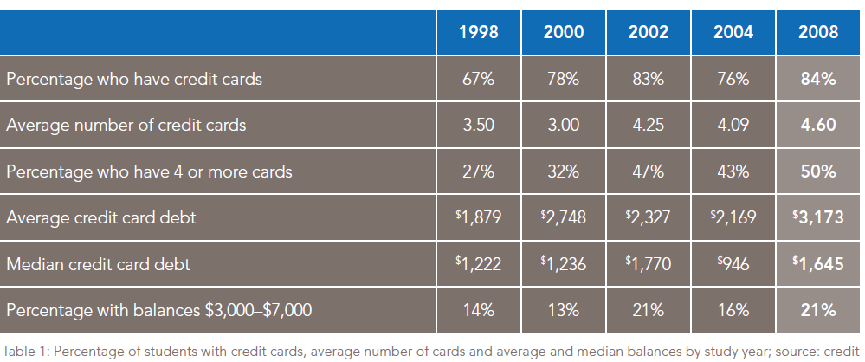
Undergraduate Students and Credit Cards
Sallie Mae’s National Study of Usage Rates and Trends
Notes:
We wanted to share some interesting statistics with you. Did you know that over 84% of college students have credits cards, with 50% having 4 or more. The average credit card debt is $3,173, with 21 % of students having balances ranging from $3,000-$7,000.
How do these statistics compare to you? How many credit cards do you have currently and what is your current monthly balance?

Slide 27
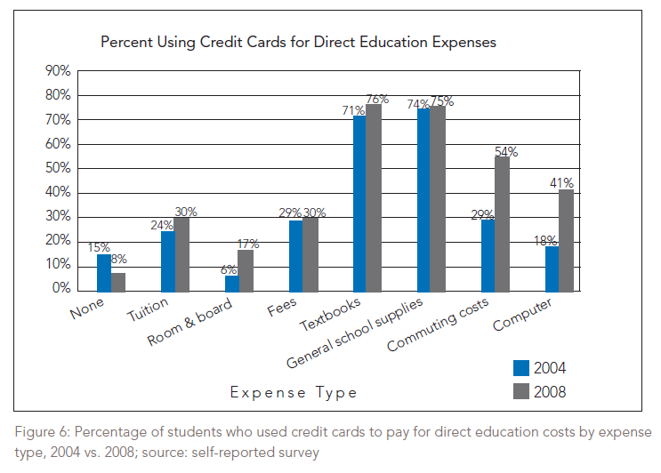
How Undergraduate Students Use Credit Cards
Sallie Mae’s National Study of Usage Rates and Trends
Notes:
This table shows that an increased percentage of students are using their credit cards for direct educational expenses. The question for you is, if you did not use a credit card to pay for items, could you cover the cost of the items with cash in your bank?

Slide 28
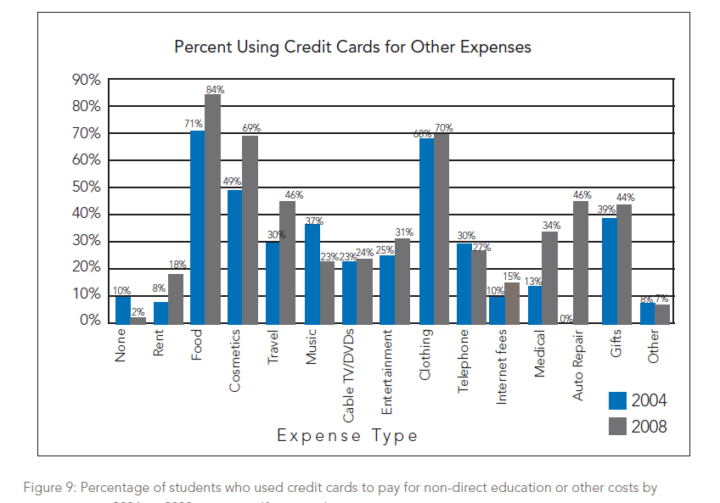
How Undergraduate Students Use Credit Cards
Sallie Mae’s National Study of Usage Rates and Trends
Notes:
Students are also using credit cards for everyday expenses. By developing a budget and sticking to it, the need for credit cards should decrease. If you are unable to purchase the item with money that you have available – it is something that can wait? It is important to reserve the use of credit cards for emergency situations only.

Slide 29
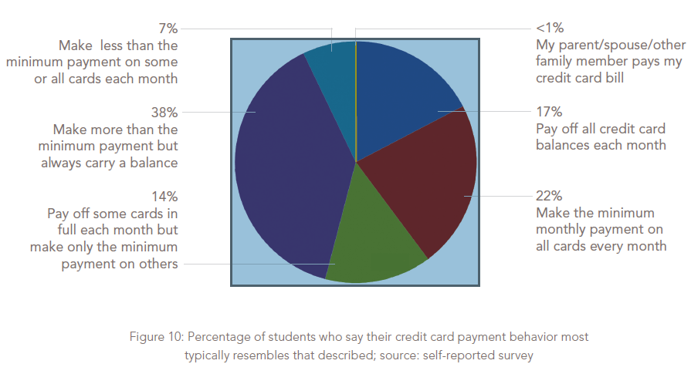
Undergraduate Students & Payment Behavior
Sallie Mae’s National Study of Usage Rates and Trends
Notes:
Where do you fall when it comes to paying off your credit card? Do you pay it off in full each month? Make minimum monthly payments? Pay of some cards but not others? Have others pay your monthly bill? Food for thought.

Slide 30
It’s Hard to Get Out …
Credit Card Scenario #1
You charge $2,500
You pay $50 per month
Yearly interest rate is 19.9%
How long will it take
to pay off?
Credit Card Scenario #2
You charge $2,500
You pay $100 per month
Yearly interest rate is 19.9%
How long will it take
to pay off?
9 years 1 month
2 years 9 months
Notes:
Most students use a variety of ways to assist them in paying for their education. These range from self-funding your education to support from outside sources such as friends or family, financial aid and/or scholarships. It is important for you to become familiar with all of these options and determine which you are able to utilize.

Slide 31

How Do I Lose Good Credit?
Making late payments.
Exceeding the credit limit on your credit card.
Writing bad checks.
Defaulting on a loan.
Filing for bankruptcy.
Identity Theft (learn how to safeguard yourself)
Credit Card Smarts
Notes:
Students with credit card debt can get into a bad situation rather quickly. Credit scores can lower when you make late payments, exceed the limit on your card, write bad check, default on a loan (including student loans!), file for bankruptcy or are even a victim of identity theft. In order to establish good credit it is important to pay off your balances in full. In the event that you cannot pay in full, make sure you are paying at least the minimum payment and that it is on time!

Slide 32
What Happens If I Have Bad Credit?
You may not be able to rent an apartment
You won’t be able to buy a house
You may not be able to purchase or lease a car
You may not be able to obtain other forms of credit
If you are able to get credit, you will pay very high interest rates
You can be turned down for a job
It’s like getting a bad grade – it stays on your permanent record
Credit History and School
Notes:
Once you have bad credit – it seems to follow you everywhere! You may not be able to rent an apartment or purchase a home, buy or lease a car. In addition, you may not be able to obtain other forms of credit. If you do, your interest rates may be very high! Use the link at the bottom to learn how your credit history can affect your admission into a professional school.

Slide 33
How Do I Access My Credit Report?
Once a year you may receive a free copy of your credit report from each of the three major credit reporting agencies:
  Equifax
  TransUnion
  Experian
You may also dispute any inaccuracies you find
Request Annual Credit Report
Keeping on Top of Your Credit Report
Notes:
It is essential for you to be aware of your credit history and score. Once a year you can receive a free copy of your credit report. If you find any inaccuracies, make sure that you work to resolve those disputes so that they do not negatively impact your future!

Slide 34
Feeling Overwhelmed?
Ask for help
Call at the first sign of trouble
  Denial of credit
  Credit cards that are maxed out
  Borrowing money to pay bills
  Paying only the minimum
Contact your student loan provider
Work out a plan to repay
Contact a Consumer Credit Counselor
Notes:
Feeling overwhelmed? Ask for help. Are you being denied credit? Are your credit cards maxed out? Are you borrowing money to pay bills? Are you only paying the minimum? If you are experiencing any of these, call for help. Talk to your creditors and advise them what your situation is. Most will work out a plan to get you back on track. Contact your student loan provider. See if you may be eligible for a deferment where you can postpone your payments until you are back on track. If you have tried everything and still feel overwhelmed, it may be time to contact a non-for-profit Consumer Credit Counseling service in your local area. They will be able to make calls to your creditors and may even be able to get you a reduced interest rate and stop any late fees you may be incurring.

Slide 35



The Choice is Yours
OR
Notes:
The choices you make today will impact the debt and financial resources you will have tomorrow. Choose Wisely and do not hesitate to access your campus resources for support as you pursue your academic goals through College.

Slide 36
Questions?

